Slide 1
Regression and ANOVA
BIO782P
2017

Slide 2
Recap

Slide 3
Comparing more than one mean
If 3 means, we would need 3 t-tests
If 4 means, 6 tests
If 5 means, 10 tests
Generally, pairwise comparisons

Slide 4
Comparing more than one mean
Probability of at least one Type 1 error:
1-(0.95^{number of tests})
For 3 means p(error) = 0.0975
For 4 means, 0.265
For 5 means, 0.401

Slide 5
ANOVA
Analysis of variance
Relies on partitioning the variance in the data into that explained by the factor(s) and that which is unexplained

Slide 6
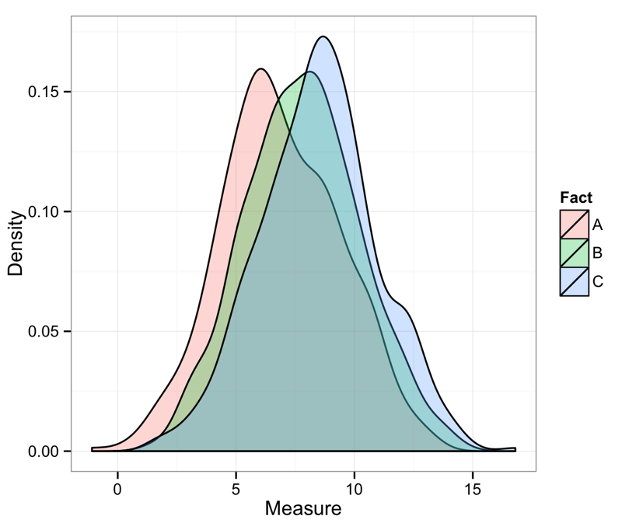
Partitioning variance

Slide 7
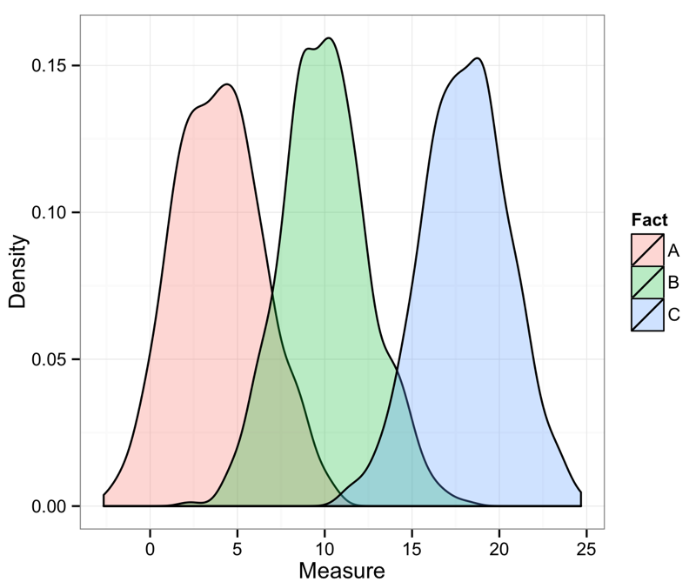
Partitioning variance

Slide 8
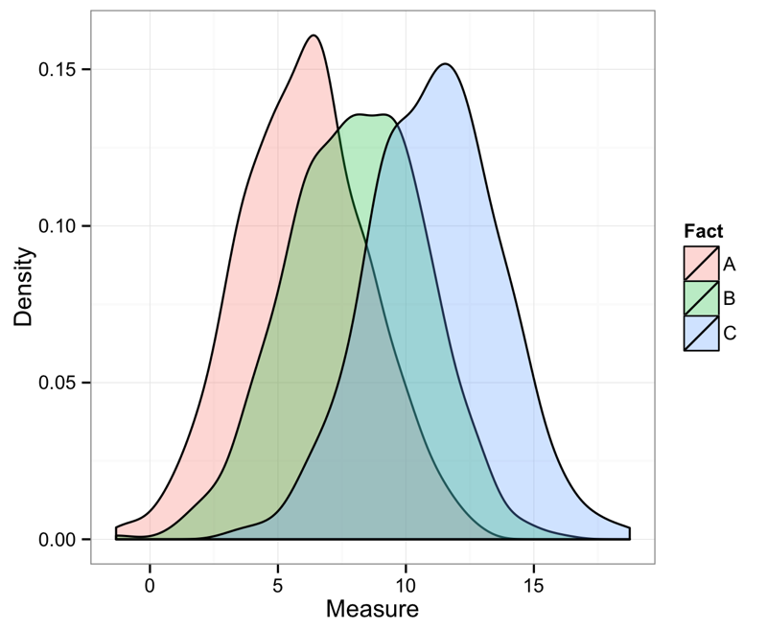
Partitioning variance

Slide 9
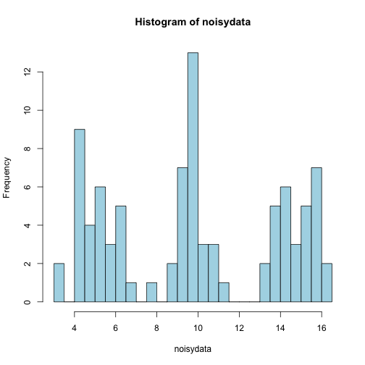
Partitioning variance

Slide 10
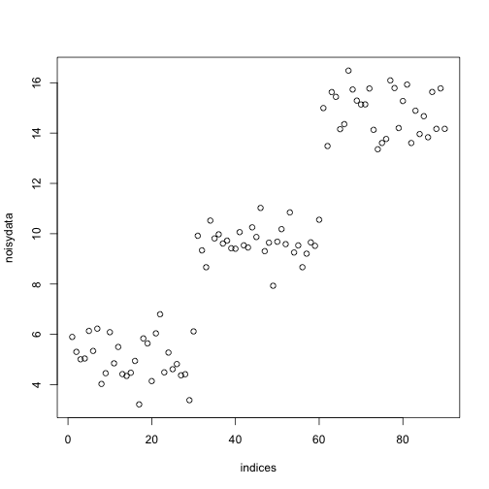
Partitioning variance

Slide 11
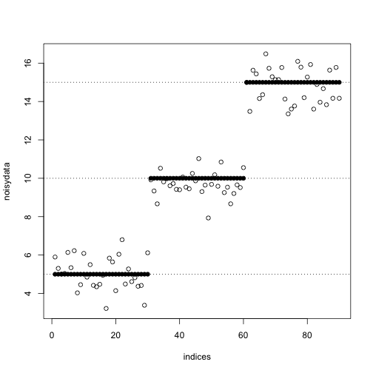
Partitioning variance

Slide 12
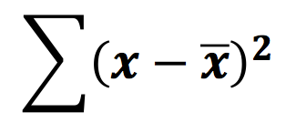
Performing ANOVA
To partition variability use sum of squares (SS) rather than variance (s²)
SS=
Easier to add and subtract SS than s² because don’t need to worry about differences in sample size
SS = s² (variance) x df

Slide 13
ANOVA
We calculate the between group variance, or the factor variance
This is compared with the within group variance, or error variance, using an F-test.

Slide 14
ANOVA table
Mean squared error: SS/df
Source | df | SS | MS
Factor | 2 | 0.0576 | 0.0288
Error | 15 | 0.1052 | 0.007
Total | 17 | 0.1628

Slide 15
ANOVA table
F ratio:
MSF/MSE
Source | df | SS | MS | F | p
Factor | 2 | 0.0576 | 0.0288 | 4.114 | 0.037
Error | 15 | 0.1052 | 0.007
Total | 17 | 0.1628

Slide 16
ANOVA
What does a significant (p<0.05) result from an ANOVA mean?
It tells us that at least one of the group means is different from at least one other
To find where differences are look at 95%CIs, look at “treatment contrasts” in summary table or use a post-hoc test like the Tukey HSD test.

Slide 17
ANOVA in R
lm() or aov()
Both can carry out ANOVA
with lm() use anova() on a model object to get an ANOVA table

Slide 18
Reporting an ANOVA
There were no significant differences in mean response between any factor levels (ANOVA, Fx,y = Z, p=0.YYY)
There were no significant differences in mean response between any factor levels (table 1)

Slide 19
Two-factor ANOVA
We can use ANOVA to analyse the results of experiments where more than on factor has been used
Example: trial measuring how inflammation is affected by drug treatment, patients given a placebo, a low dose or a high dose and also classified by sex

Slide 20
Two-factor ANOVA
Two factor ANOVA allows us to test for MAIN EFFECTS and also for INTERACTIONS
A main effect is the effect of one factor in isolation
An interaction is the effect of one factor when the level of the other factor is taken into account

Slide 21

Main effects and interactions

Slide 22
ANOVA assumptions
Normally distributed errors
Homoscedasticity
Observations are independent

Slide 23
Regression
Sometimes we want to make predictions from one variable of another
Use regression analysis to fit a line
One variable is independent and one is dependent

Slide 24
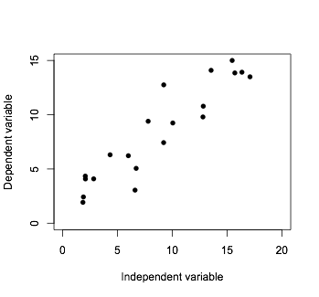

Slide 25
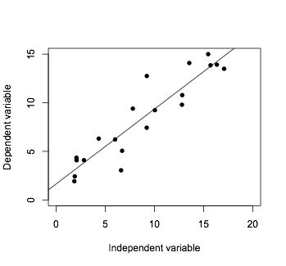

Slide 26
Examples
Height (dependent variable) against time (independent)
Patient response (dependent) against drug dose (independent)
MCQ test score (dependent) against attendance (independent)

Slide 27
b is the slope of the line
Describe relationship with:
y = a + bx
y is dependent
(score)
x is independent
(attendance)
a is the intercept of the line

Slide 28
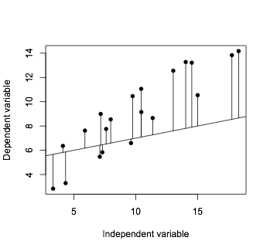
Line fitted by method of least squares

Slide 29
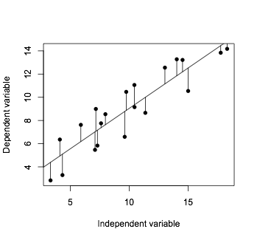
Line fitted by method of least squares

Slide 30
y = a + bx
If we have values for a and b, we can predict the value of y for a given value of x
a is the score when x = 0
b is the increase in y per unit increase in x

Slide 31
In R
Use lm() function
The variables used for the regression must be specified as a formula dependent~independent

Slide 32
Checking your regression
Several things you need to check including:
Structure in the data
Error distribution
Variance structure
Linearity

Slide 33
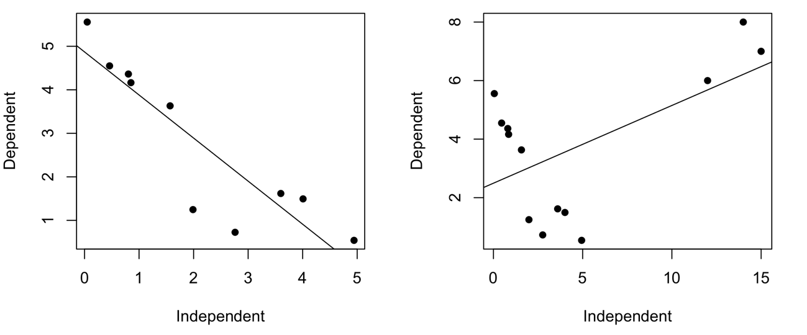
Structure in the data
Be careful of outliers and groups. A few points at the end of a data distribution can have a big influence on the fitted line
p=0.0005
p=0.04

Slide 34
Error distribution
Linear regression assumes normal errors
Check by looking at histogram of residuals or qq-plot

Slide 35
Homogeneity of variance
Linear regression assumes variance is constant for all values of the independent variable
Check by looking at a plot of residuals vs fitted values

Slide 36
Linearity
Linear regression assumes a straight line relationship between variables
Check by looking at scatterplots and plots of residuals vs fitted values

Slide 37
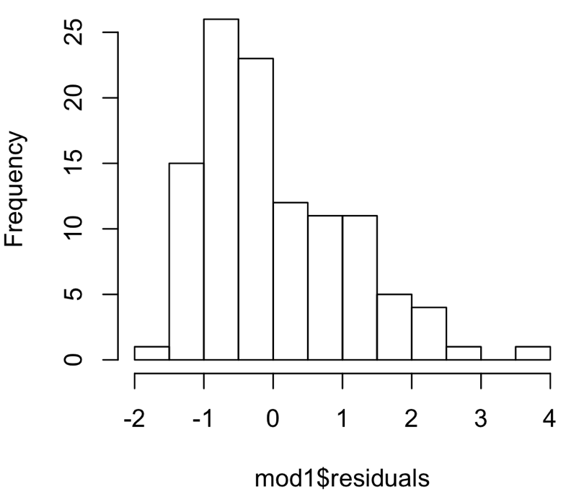
In R
To get a histogram of residuals use hist(model$residuals)

Slide 38
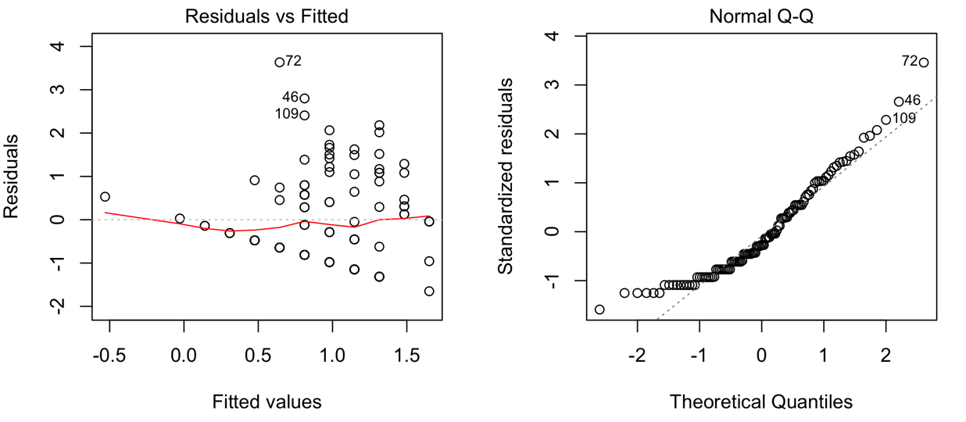
In R
To get other diagnostic plots use plot(model). The first two are residuals vs fitted and a qq-plot of residuals

Slide 39
Confidence intervals
Can estimate 95% CI for fitted line
Indicates region we are 95% certain the best fit of the line lies

Slide 40
Prediction intervals
Can calculate 95% PI for estimates of the dependent variable
Indicates region we are 95% certain predictions of the dependent lie
95% PI always exceed CI

Slide 41
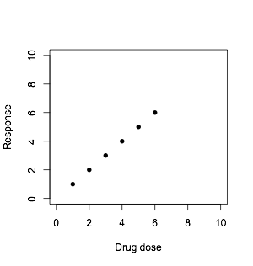
Extrapolation
Avoid EXTRAPOLATION: estimating dependent variables from a regression equation outside the range of your data

Slide 42
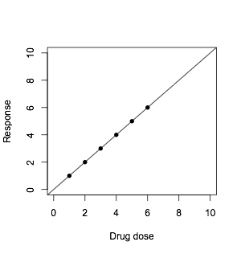
Extrapolation
Avoid EXTRAPOLATION: estimating dependent variables from a regression equation outside the range of your data

Slide 43
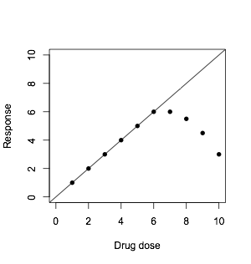
Extrapolation
Avoid EXTRAPOLATION: estimating dependent variables from a regression equation outside the range of your data

Slide 44


Slide 45
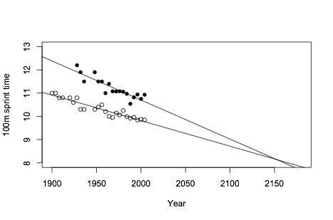

Slide 46
Women’s sprint times
Fitted model is y=44.34-0.001682*year
Light takes 3.3x10⁻⁷ seconds to travel 100m
3.3x10⁻⁷=44.34-0.001682*year
(3.3x10⁻⁷-44.34)/-0.001682=2636
Women will be sprinting at the speed of light in the 2636 olympics.

Slide 47
Comparing regression lines
Several ways
Easiest to use ANCOVA
Use the independent variable as covariate
E.g. compare regressions of male & female scores against attendance

Slide 48
Multiple regression
Can use more than 1 independent variable to predict a dependent
y = a + b1x1 + b2x2
E.g. plant growth is dependent on light and rainfall

Slide 49
Summary
Correlation and regression are not the same
Correlation is used to measure the strength and significance of a relationship
Regression fits a line to your data to allow estimates of the dependent variable to be made from the independent
For both correlation and regression
Data must have normal errors
Variances must be similar across the relationship

